Slide 1
CSC 4195 Research Methodology
CSC 4195 Research Methodology
1b
1
Fall 2022-2023
Dr. Afroza Nahar, Associate Professor,
Department of Computer Science, Faculty of Science & Technology.
afroza@aiub.edu

Slide 2
Course Outlines
What is/ Why do/ How to conduct Research
Problem identification and logical thinking (or hypothesis)
Literature review
Research Proposal writing
Research Ethics
Paper writing
Report Writing
Tools: EndNote
Making a Presentation
Oral Presentation

Slide 3
Course Objectives
To understand the meaning of research
what is research
To understand the objectives of research
why do research
To understand the meaning of research methodology
What is Methodology
To understand the basic steps of conducting research
How to do research

Slide 4
Learning Outcomes
At the end of this course, the student will be able to:
To learn the research strategies and tactics
To identify suitable research problem
To learn to render experimental design
To apply statistical methods in research
To develop technical writing & oral presentation skill
To prepare technical paper/ thesis/ dissertation

Slide 5
Why do research?
Validate intuition
Improve methods
Demands of the Job
For publication
To get a degree
To get respectability
To face a challenge
To solve a problem
To get intellectual joy
To serve the society

Slide 6
Importance of knowing the subject RM
A student preparing himself for a career of carrying out research as his profession
Will be trained better to do research
Will help him to develop disciplined thinking
Will help him observe the field objectively.
Will enable thoroughly to understand the logic behind the research problem.
Will increase the ability to evaluate the results.
Face the evaluated results with confidence.
Useful in various fields such as Govt. Business, administration, community development & social work.

Slide 7
What is Research?
Research: composed of two syllables “Re” and “Search”.
Re: means again / over again / a new
Search: test and try / to examine closely

Slide 8
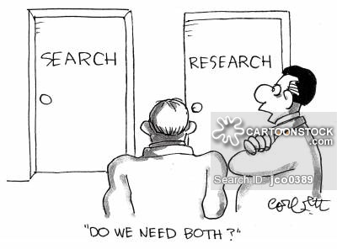
What is Research?
Research is a systematic inquiry that investigates hypotheses, suggests new interpretations of data or texts, and poses new questions for future research to explore.

Slide 9
Research can also be defined as:
Search for knowledge
Systematic and scientific search for getting relevant answers on any taken up specific topic.
Scientific enquiry into a subject.
Research is a movement from the unknown to the known.
It is the voyage of discovery

Slide 10
Acc to Bulmer,
“Research is primarily committed to establishing systematic, reliable and valid knowledge about the social world.”

Slide 11
Acc. To Clifford Woody, -----------
Defining and redefining problems.
Formulating hypothesis (basic idea)
Collecting data
Organizing data
Evaluating data
Making decisions
Suggesting solutions
Reaching conclusions
Finally, carefully testing the conclusions
To determine whether they fit the formulated Hypothesis.

Slide 12
Purpose of conducting research ... contd.
To fill in the gaps of our knowledge about a particular field.
To identify a new problem.
To test a new solution for an existing issue or phenomenon.

Slide 13
Research consists of ... contd.
Asking a question that nobody has asked before.
Doing the necessary work to find the answer.
Communicating the knowledge you have acquired to a larger audience.

Slide 14
Common Mistakes in Research
Failure to -
Establish the reason for the research
Provide clear & concise objectives
Provide complete reference to prior research on the subject and methods
Lack of understanding for the conceptual and theoretical basis
Selection of analytical structural model for mere empirical convenience (or familiarity)
Presenting conclusions that are merely restatements of analytical findings
SEC: J

Slide 15
Types of Research
Research Types
Perspective
Application
Objectives
Enquiry Mode
Manipulation
Basic Research
Applied Research
Quantitative Research
Qualitative Research
Obtrusive Research
Non-obtrusive Research
Descriptive Research
Exploratory Research
Correlational Research
Explanatory Research

Slide 16
Types of Research ... contd.
Basic vs. Applied Research :
Basic or pure or fundamental research involves
Developing and testing theories and hypotheses that are intellectually challenging to the researcher but may or may not have practical application at present
Development, examination, verification and refinement of research methods, procedures, techniques and tools that form the body of research methodology.
e.g. : developing a sampling technique that can be applied to a particular situation.

Slide 17
Types of Research ... contd.
Basic vs. Applied Research
Applied research involves
Collection of information about various aspects of a situation, issue, problem or phenomenon so that the information gathered can be used in other ways.
The purpose of applied research is to solve an immediate practical problem

Slide 18
Types of Research ... contd.
Obtrusive vs. Non-obtrusive Research
In obtrusive research researcher introduces conditions that influence participants and manipulates the environment.
In non-obtrusive research researcher avoids influencing subjects in any way and tries to be as inconspicuous as possible.

Slide 19
Types of Research ... contd.
Quantitative vs. Qualitative Research
Quantitative research
A structured approach of enquiry where everything that forms a research process (objectives, design, sample, etc.) is predetermined
More appropriate for determining the extent of a problem

Slide 20
Types of Research ... contd.
Quantitative vs. Qualitative Research
Qualitative research
An unstructured approach of enquiry that allows flexibility in all aspects of the research process
A more appropriate for determining the extent of a problem

Slide 21
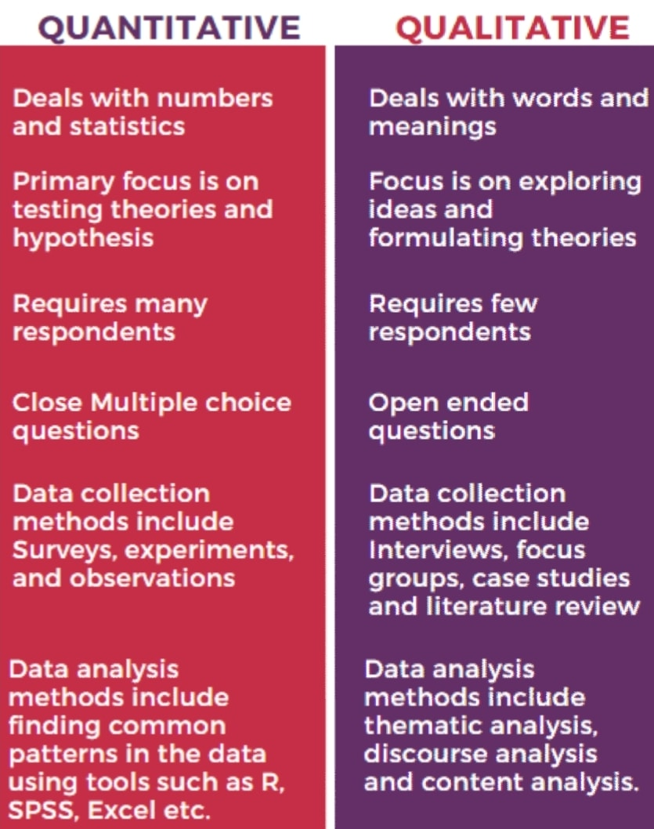
QUANTATIVE vs QUALITATIVE

Slide 22
Types of Research ... contd.
Choice between quantitative and qualitative approaches depends on:
aim of the enquiry (exploration, confirmation or quantification)
use of the research findings (policy making or process understanding)
Mixed methods involves combining both qualitative and quantitative study and data in a research

Slide 23
Types of Research ... contd.
Research types from objective perspective
Descriptive research
Describes systematically a situation, problem, phenomenon, service or programme, or provide information
The main purpose of such studies is to describe what is prevalent with respect to an issue/problem under study.
e.g. describing the living condition of Maori tribes in New Zealand

Slide 24
Types of Research ... contd.
Research types from objective perspective
Correlational research
Discover or establish the existence of a relationship/association/interdependence between two or more aspects of a situation
e.g. What is the relationship between technology and unemployment?

Slide 25
Types of Research ... contd.
Research types from objective perspective
Explanatory research
To clarify why and how there is a relationship between two aspects of a situation or phenomenon
e.g. Why stressful living results in heart attacks?

Slide 26
Types of Research ... contd.
Research types from objective perspective
Exploratory research
To explore an area of knowledge very little known or to investigate the possibilities of undertaking a particular research
When a study is carried out to test its feasibility, it is called pilot study. conducted to develop, refine and/or test measurement tools and procedures

Slide 27
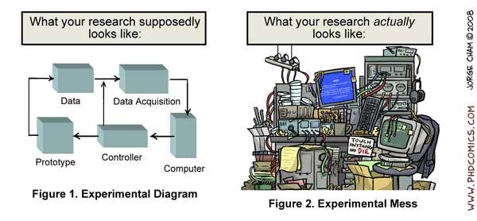
Research Process
A research plan is the key to successful research. The approach to the research needs to be carefully constructed and designed.

Slide 28
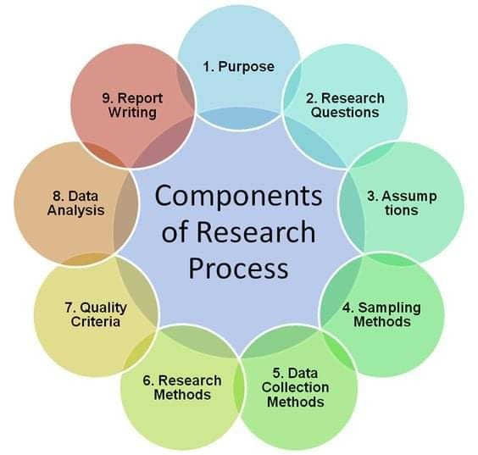
Research Process ...contd.

Slide 29
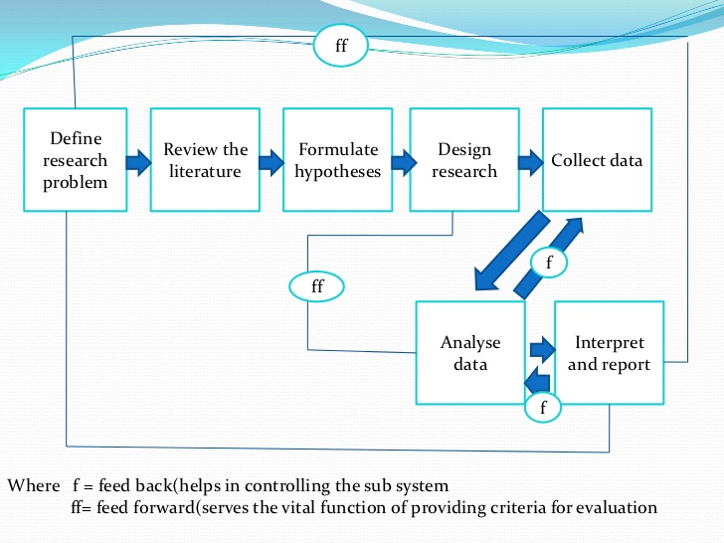
Research Process ...contd.

Slide 30
Research Process ...contd.
Step 1: Define Research Problem
Defining of a research problem aptly is crucial to attain veritable solution of a problem
Two basic types of research problems
problems related to states of nature
problems defining the relevance among variables
Defining a research problem is two-step process
To realize the problem thoroughly and minutely
To rephrase it into meaningful physical and/or mathematical terms

Slide 31
Research Process ...contd.
The research question can be phrased using one of the following questioning words:
1. Why?
•Example: Why did the wind turbine fail in 100 kph winds?
2. What?
•Example: What is the effect on the strength of concrete when recycled concrete is used in the mix?
3. How?
•Example: How can the braking system of a railway carriage be self- activating when its velocity exceeds a threshold value?
4. When?
•Example: When will the roof bolts in an underground tunnel fail through environmental degradation?

Slide 32
Research Process ...contd.
Step 2: Review of Literature
Literature reviews are necessary
To frame a research project
To ensure that your research question has not already been examined

Slide 33
Research Process ...contd.
Step 3: Formulate the Hypothesis or Problem Statement
A research hypothesis is an educated prediction that provides an explanation for an observable event or condition
A problem statement is both a reiteration of the research problem along with the justification for studying it.

Slide 34
Research Process ...contd.
Objectives are the goals you set out to attain in your research.
Both your main objectives and your sub-objectives need to be formulated, which arise out of your research questions.
The main objective is an overall statement of the thrust of your research.
The sub-objectives are the specific aspects of the topic that you want to investigate within the main framework of your study.
Use action-oriented words such as ‘to find out’, ‘to determine’, ‘to ascertain’ and ‘to examine’.

Slide 35
Research Process ...contd.
Step 4: Select a Research Design
Selection of research design depends on
Will the research be qualitative or quantitative?
What methodology and design are to be chosen?
What methods, techniques and tools will be used to collect, analyze, and interpret the data?

Slide 36
Research Process ...contd.
Step 5: Collect Data
Experimentation or Survey
Step 6: Analyse Data
Manipulating data in a number of different ways, such as
Plotting it out and finding correlations
Creating a pivot table to sort and filter data by different variables and calculate the mean, maximum, minimum and standard deviation of data

Slide 37
Research Process ...contd.
Step 7: Interpret Data and Report/Conclution
Interpretations must be supported by the evidence.
Avoid spurious conclusions of causality or correlation!

Slide 38
Philosophical Worldviews
Post-positivism
Traditional form of research, also known as positivism, empirical science, scientific method, etc.
Identify and assess the cause that influence outcomes (experimental results)
Hold true more for quantitative research

Slide 39
Philosophical Worldviews ...contd.
Constructivism
An approach of qualitative research, also known as social constructivism (often combined with interpretivism)
The goal of the research is to rely as much as possible on the participants’ views of the situation being studied
The questions become broad, general and open-ended so that the participants can construct the meaning of a situation, typically forged in discussions or interactions with other persons.

Slide 40
Philosophical Worldviews ...contd.
Transformative Worldview
A transformative worldview holds that research inquiry needs to be intertwined with a political change agenda to confront social oppression at whatever levels it occurs.
The research contains an action agenda for reform that may change lives of the participants, the institutions in which individuals work or live
e. g. - research on social issues such as empowerment, inequality, oppression, etc.

Slide 41
Philosophical Worldviews ...contd.
Pragmatism
Mainly focus on prescriptive knowledge (what ought to be) and emphasize problem solving
Researchers look to the what and how of research and where they want to go with it
Pragmatism plays the greatest role in problem-solving research.

Slide 42
Research Terminology
Method vs. Methodology
Method refers to an specific details and/or procedures to accomplish a task to attain a certain goal.
e.g. – regression analysis, optimization models, etc.
Methodology refers to the study of the methods involved in some field, endeavour, or in problem solving.
e.g. – a collection of theories, concepts or ideas; a comparative study of different approaches, etc.

Slide 43
Research Terminology
Hypothesis vs. Thesis (Theory)
Hypothesis is an educated guess based upon observation. It is a rational explanation of a single event or phenomenon based upon what is observed, but which has not been proved.
A theory (thesis) is a statement declares what you believe and what you intend to prove.
When a hypothesis passes test it is adopted as a theory (or thesis) as it correctly explains a range of phenomena but it can, at any time, be falsified by new experimental evidence.

Slide 44
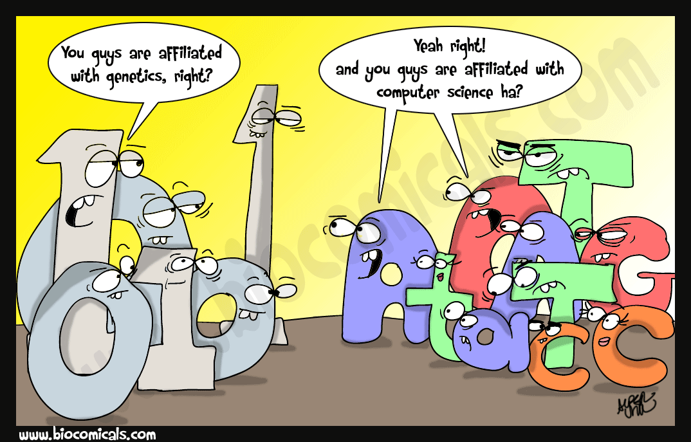
Research in Computer Science (CS)
Computer Science as a research discipline has always struggled with its identity
It is a field deeply rooted in mathematics

Slide 45
Research in CS ....contd.
Research culture in CS:
Inherently multidisciplinary (no other field is so multidisciplinary as computer science)
Planned and specific purpose
Clear start and finish dates
Finite resources (lack of skilled people)
CS has a long tradition of using conference publications as the primary unit of dissemination (which is in contrast with other scientific disciplines where emphasis is on journal publications)

Slide 46
Research areas in CS ....contd.
Algorithm and complexity
Artificial intelligence and Machine learning
Biomedical and Computational biology
Computer architecture and design
Computer graphics and visualization
Computer vision
Network and distributed systems
Operating systems
Programming languages and systems
Scientific and numerical computing
Security, privacy and cryptography
Software engineering

Slide 47
Research areas in CS ....contd.
Research Areas in CS
Medical Informatics
Multimedia computing
Network and distributed systems
Operating systems
Software engineering
Multimedia computing
Programming languages and systems
Scientific and numerical computing
Security, privacy and cryptography
Database and Data mining
Embedded systems

Slide 48
Research areas in CS ....contd.
Knowledge Processing
Data mining methods for linked data
Machine learning methods for semantic integration
Image Analysis
Content-based image retrieval
Fusion process
Computer vision
3D Object modeling using a range scanner
Recognizing human activities from video
Multiple-view geometry
Video content analysis
Surveillance video analysis
High-level feature extraction
Video search task

Slide 49
Research areas in CS ....contd.
Computer-assisted education
Bio-informatics and other uses of CS in biology, biomedical engineering, and medicine
Artificial intelligence and robotics
Abundant-data applications, algorithms, and architectures

Slide 50
Research areas in CS ....contd.
Databases, data centers, information retrieval, and natural-language processing
indexing, search on massive collection of DATA
helping computers understand human-generated documents
interactions with abundant-data applications
Emerging technologies for computing hardware, communication, and sensing:
optical and quantum computing
three-dimensional integrated circuits and a variety of new memory chips
Modeling and using new types of electronic switches
quantum communication and cryptography

Slide 51
Research areas in CS ....contd.
Human-computer interaction
H-C interface design to detect emotions, intent, level of skill)
design of human-facing software (social networks) and hardware (talking smart-phones and self-driving cars)
Large-scale networking:
high-performance hardware for data centers
mobile networking
support for more efficient multicast
high-level user-facing services (social networks), networking services for developing countries (without permanent high-bandwidth connections)
Outer-space communication networks.
Network security is also a big deal.

Slide 52
Research areas in CS ....contd.
Multimedia:
graphics, audio , video – analysis, compression, generation, playback, multi-channel communication etc.
synthesizing realistic multimedia, etc.
Programming languages and environments:
Automated analysis of programs in terms of correctness and resource requirements
Software support for languages, program optimization, support for parallel programming,
Security of computer systems and support for digital democracy
network-level security
OS-level security
physical security (biometrics, tamper-proof packaging, trusted computing on untrusted platforms),
support for personal privacy (efficient and user-friendly encryption),

Slide 53
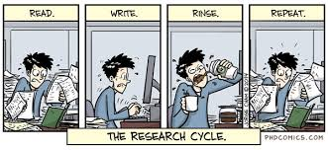

Slide 54
Exercise 2
Select an area of study that interests you from within your academic discipline.
Within that area, what research questions do you hope to answer? (Be as specific as possible. You can select one or as many subareas as you want.)
Formulate the main objective and the subobjectives of your study.
What, in your opinion, is the relevance of this study to theory and practice? How will your study contribute to the existing knowledge?

Slide 55
Exercise 1
After reading a published research paper, write down the research question you think the authors have addressed in undertaking this research. Do you think the paper adequately supports the conclusions reached in addressing this question?

